Slide 1
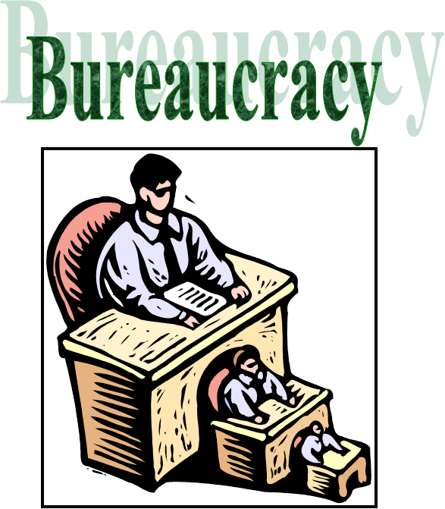
Rule By Desks—Bureaucracy

Slide 2
A professional corps of unelected officials organized in a pyramid hierarchy, functioning under impersonal uniform rules and procedures.

Slide 3
How are they hired?
Civil Service Exam https://www.csealearningcenter.org/demo/templates/contentTemp.cfm?TID=1
Foreign Service Exam https://www.csmonitor.com/World/2011/0127/Are-you-smarter-than-a-US-diplomat-Take-our-Foreign-Service-Exam/Economics-101
Meritocracy….

Slide 4
4 million employees; 2.8 million are civilians or “civil servants”
President only appoints 3% (patronage or political appointments)
15 cabinet level departments
200+ independent agencies with 2,000+ bureaus, divisions, branches, etc.
Biggest - Department of Defense, U.S. Postal Service, Veterans Administration

Slide 5
Bureaucracies are organized into:
Cabinet departments
Regulatory Agencies
Government Corporations
Independent Executive Agencies

Slide 6
15 Cabinet Departments
Each has its own staff & budget
Each is supervised by a secretary (confirmed by Senate)
Each is considered “expert” in own area
Homeland Security is the newest (2002)

Slide 7
Bureaucracies are organized into:
Cabinet departments
Regulatory Agencies
Government Corporations
Independent Executive Agencies

Slide 8
Regulatory Agencies
Oversee a specific aspect of the economy
Intended to operate independently of Congress and the Executive
Create regulations that protect people
Can enforce regulations by judging disputes
Headed by a commission (Confirmed by Congress) rather than a secretary
Once confirmed, cannot be removed without cause
Closely involved with interest groups that want to influence regulations
Federal Communication Commission
Federal Reserve Board

Slide 9
Bureaucracies are organized into:
Cabinet departments
Regulatory Agencies
Government Corporations
Independent Executive Agencies

Slide 10
Government Corporations
Perform service for a fee, like a private business
Government owned
May or may not make a profit, but serve a “public need”
USPS is the largest
Amtrak
Corporation for Public Broadcasting

Slide 11
Bureaucracies are organized into:
Cabinet departments
Regulatory Agencies
Government Corporations
Independent Executive Agencies

Slide 12
Independent Executive Agencies
All other executive bodies
Established by Congress as outside the Executive Branch
Perform a service function, not a regulatory one
Heads appointed by president
NASA
CIA
EPA

Slide 13
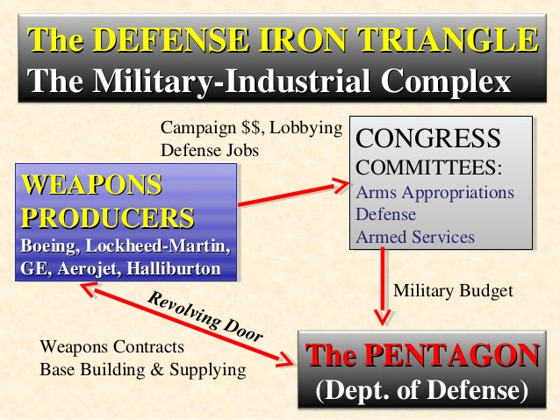
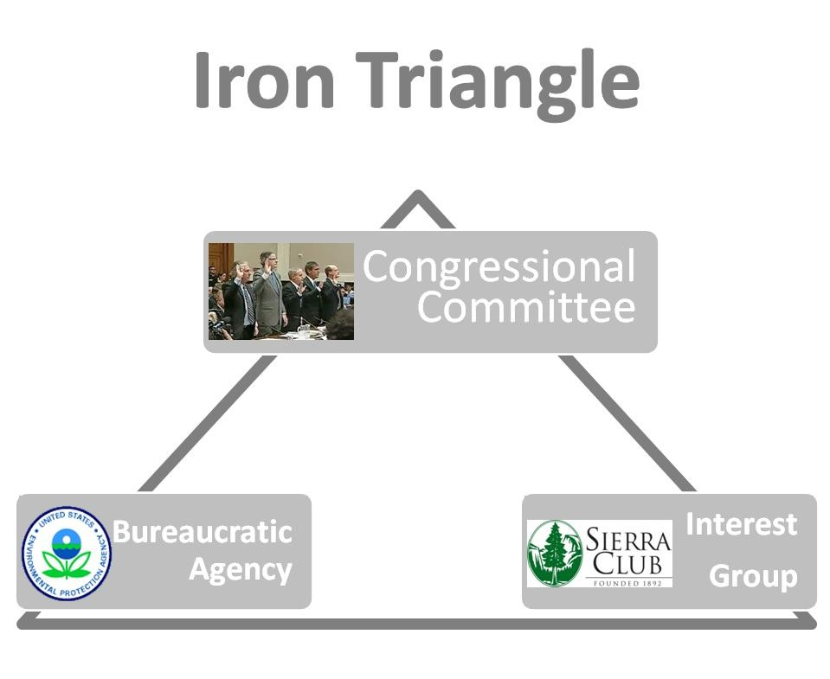
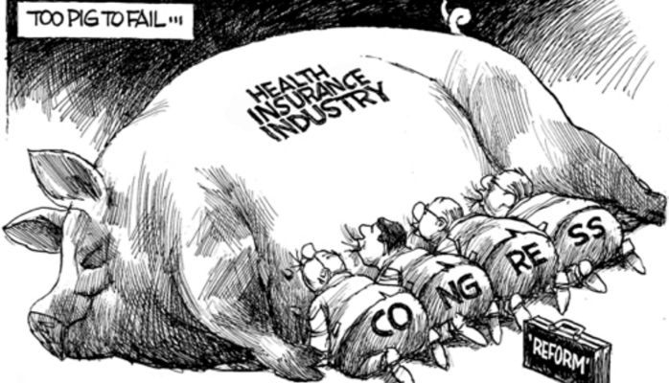
Iron Triangles

Slide 14
Who are the bureaucrats?
97% are career government employees or civil servants
Only 10% live in the D.C. area
30% work for the Department of Defense
Less than 15% work for social welfare agencies
Most are white collar workers: secretaries, clerks, lawyers, inspectors & engineers
Civil employees more diverse demographically than Congress

Slide 15
Oversight of the Federal Bureaucracy
The President can:
appoint & remove agency heads
reorganize the bureaucracy
issue executive orders
reduce an agency's budget
Congress can:
create or abolish agencies & departments
cut or reduce funding
investigate agency activities
hold committee hearings
pass legislation that alters an agency's functions
influence or even fail to confirm presidential appointments
The Federal Courts can:
through judicial review rule on whether the bureaucracy has acted within the law and the U.S. Constitution
provide due process for individuals affected by a bureaucratic action
Thinking Critically
Of the tools at his disposal, what is the most effective check the President has on the bureaucracy? Explain. Congress? The Judiciary?
How does the federal bureaucracy fit with our class definition of “bureaucracy?”
What generalizations can you make about the federal bureaucracy?
Why is the federal bureaucracy often referred to as “the fourth branch?”
Some critics believe that the real power in the federal government lies with the federal bureaucracy. To what extent do you believe this is true?

Slide 16
In the news….
http://www.realclearpolitics.com/video/2017/02/23/stephen_bannon_pillar_of_trumps_platform_is_deconstruction_of_the_administrative_state.html
https://www.youtube.com/watch?v=JtN4h7giLAw CPB
https://www.nytimes.com/2017/11/24/us/politics/state-department-tillerson.html

